Slide 1
Question 9 (pg 12-14)

Slide 2
Question 9
The final question always looks like this. It’s predictable
Worth 12 marks - one fifth of the total paper
This is worth 2 grades by itself
Notes:
P2 is 35; D2 is 46 = 11 marks

Slide 3
Question 9
Aim to spend 20-25 minutes just on this question
Aim to fill the space provided at least - 33 lines
Notes:
P2 is 35; D2 is 46 = 11 marks

Slide 4
Question 9
The command word is always discuss
Notes:
P2 is 35; D2 is 46 = 11 marks

Slide 5
The command word is always discuss
Notes:
P2 is 35; D2 is 46 = 11 marks

Slide 6
Question 9
Discuss - present, explain and evaluate points for and against an argument
Notes:
P2 is 35; D2 is 46 = 11 marks

Slide 7
Question 9
Discuss - present, explain and evaluate points for and against an argument
Write about it
Notes:
P2 is 35; D2 is 46 = 11 marks

Slide 8
Question 9
Discuss - present, explain and evaluate points for and against an argument
Write about it
in some detail
with strengths and weaknesses
and possible improvements
Notes:
P2 is 35; D2 is 46 = 11 marks

Slide 9
Question 9

Slide 10
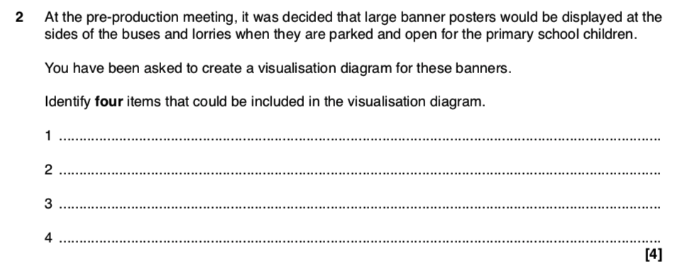
Question 9

Slide 11
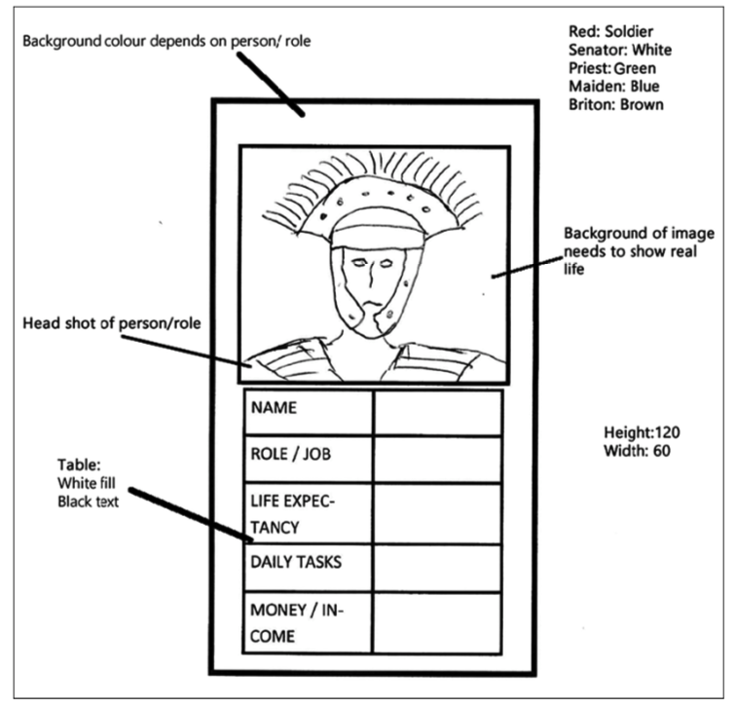
Question 9
Notes:
P2 is 35; D2 is 46 = 11 marks

Slide 12
Question 9
Notes:
P2 is 35; D2 is 46 = 11 marks

Slide 13
Question 9
Notes:
P2 is 35; D2 is 46 = 11 marks

Slide 14
strengths and weaknesses
possible improvements
Notes:
P2 is 35; D2 is 46 = 11 marks

Slide 15
Question 9
Script B
Notes:
P2 is 35; D2 is 46 = 11 marks

Slide 16
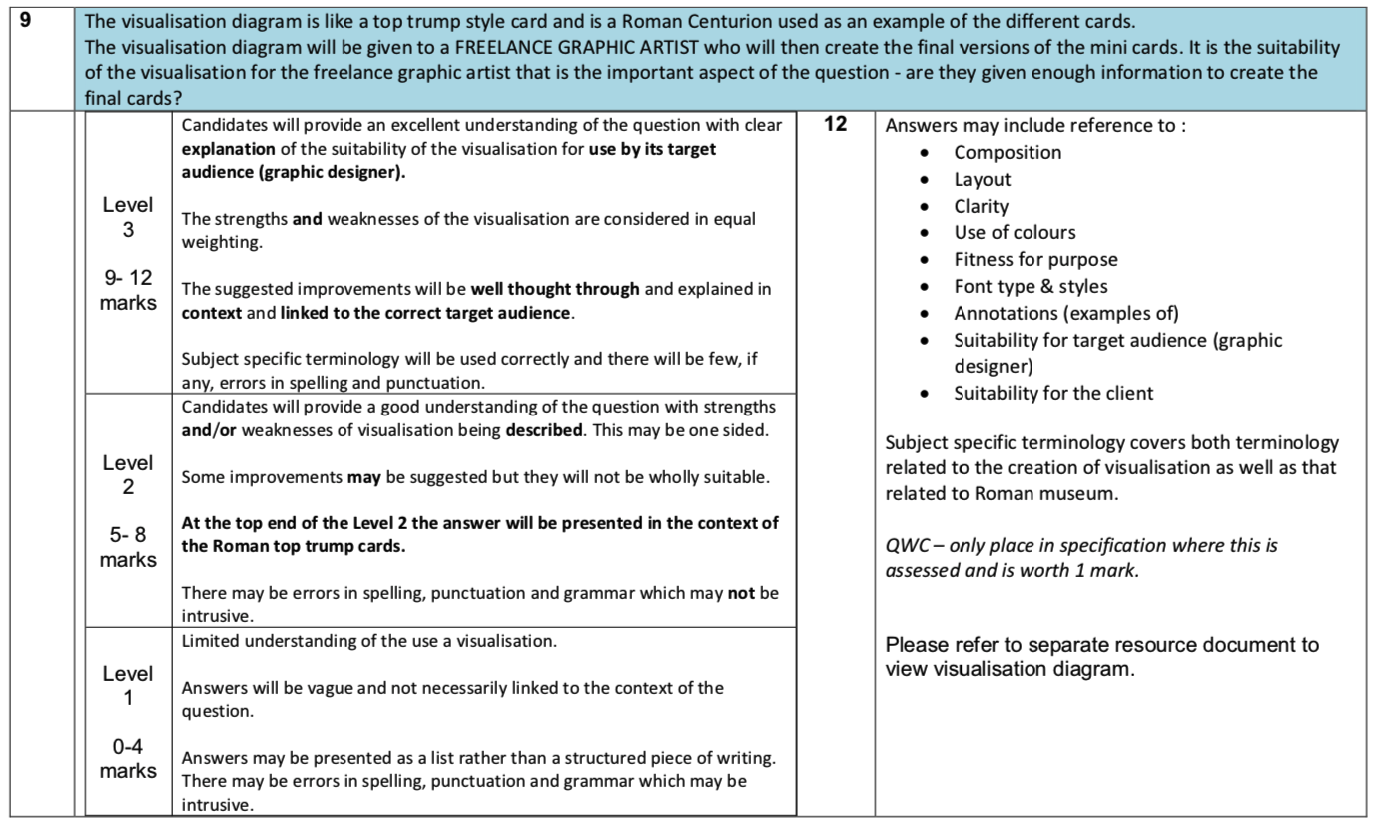
Question 9
Notes:
P2 is 35; D2 is 46 = 11 marks

Slide 17
Question 9
Script B - what level is the answer?
Level 1 - vague, little understanding of what a visualisation diagram is for
Level 2 - better understanding, strengths and/or weaknesses, possibly some improvements
Level 3 - good understanding, both strengths and weaknesses, thoughtful improvements, linked to target audience
Notes:
P2 is 35; D2 is 46 = 11 marks

Slide 18
Question 9
Once you have a level, what mark?
Level 2 -
better understanding,
strengths and/or weaknesses - may be unbalanced,
possibly some improvements
at top end of level 2 in context of top-trump cards
may be some errors in spelling etc…
Notes:
P2 is 35; D2 is 46 = 11 marks

Slide 19
Question 9
QWC
spelling, punctuation, grammar - sentences, paragraphs etc… Connectives help
technical terms used well
Notes:
P2 is 35; D2 is 46 = 11 marks

Slide 20
Question 9
Once you have a level, what mark?
Level 2 -
better understanding,
strengths and/or weaknesses - may be unbalanced,
possibly some improvements
at top end of level 2 in context of top-trump cards
may be some errors in spelling etc…
Notes:
P2 is 35; D2 is 46 = 11 marks

Slide 21
Question 9
Script C - what level is the answer?
Level 1 - vague, little understanding of what a visualisation diagram is for
Level 2 - better understanding, strengths and/or weaknesses, possibly some improvements
Level 3 - good understanding, both strengths and weaknesses, thoughtful improvements, linked to target audience
Notes:
P2 is 35; D2 is 46 = 11 marks

Slide 22
Question 9
The target audience is the key to getting into Level 3
Notes:
P2 is 35; D2 is 46 = 11 marks

Slide 23
Question 9
Notes:
P2 is 35; D2 is 46 = 11 marks

Slide 24
The command word is always discuss
Notes:
P2 is 35; D2 is 46 = 11 marks

Slide 25
Question 9
Script D - what level is the answer?
Level 1 - vague, little understanding of what a visualisation diagram is for
Level 2 - better understanding, strengths and/or weaknesses, possibly some improvements
Level 3 - good understanding, both strengths and weaknesses, thoughtful improvements, linked to target audience
Notes:
P2 is 35; D2 is 46 = 11 marks

Slide 26
Question 9
Script D - what level is the answer?
Notes:
P2 is 35; D2 is 46 = 11 marks

Slide 27
Question 9
Script A - what level is the answer?
Level 1 - vague, little understanding of what a visualisation diagram is for
Level 2 - better understanding, strengths and/or weaknesses, possibly some improvements
Level 3 - good understanding, both strengths and weaknesses, thoughtful improvements, linked to target audience
Notes:
P2 is 35; D2 is 46 = 11 marks

Slide 28
Question 9
Script E - what level is the answer?
Notes:
P2 is 35; D2 is 46 = 11 marks

Slide 29
Question 9
How to do well:
read the question and the stem
look at the diagram in detail
write. In detail
remember how the markscheme works
strengths and weaknesses
suggest improvements
link to the target audience - name it
don’t use bullet points
Notes:
P2 is 35; D2 is 46 = 11 marks

